Slide 1
Practical enterprise applications
It has been a great journey
CODE ACADEMY OHRID v1.0

Slide 2
Who are we?
It has been great year, we’ve learnt a lot but the best is yet to come:
– we are acquaintances for almost a year, we’ve covered a lot of web development topics together
– time for the final touch to learn why software is build the way it is
– Introduction to more advanced programing concepts you will need in real life

Slide 3
Software architecture Do we just start building house?

Slide 4

Monolith applications
• Hard to maintain
• Hard to change
• No way to reuse parts of the code

Slide 5
Task I
Take a look at the Real estate agency application and the following documentation:
The application should be able to save real estate with information for location, rent price, sale price and area
The application should present summary of total area, average rent price and average sale price
The application should present list of current real estate in the agency

Slide 6
Task II
Change the application repository to use database with Entity Framework

Slide 7
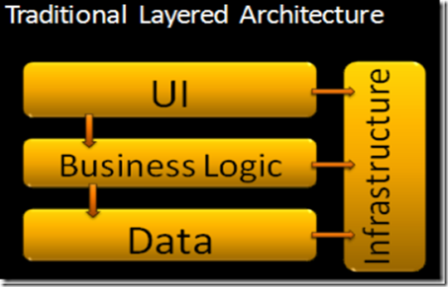
N Layered architecture
Clearly separated UI, Business and data infrastructure
Easier to understand
Again coupled layers, hard to make bigger infrastructure changes
Business layer depends on database

Slide 8
What is dependency and why it is bad ?
Dependency is a broad software engineering term used to refer when a piece of software relies on another one. Coupling (computer programming) In software engineering, coupling or dependency is the degree to which each program module relies on each one of the other modules. Program X uses Library Y.
References in projects are dependencies
new directive in classes is dependency to another class
using static classes in our code is dependency
Third party services and modules are dependency

Slide 9
What is dependency and why it is bad ?
Changes in dependent objects require changes in our code, even more in our business logic.
Simple changes may produce errors in our business logic. We don’t want third party services or modules to produce errors in our code
In our code we don’t want high modules (business logic) to depend from low level modules (UI, database, services…). We don’t want changes in these low level modules to produce errors in our business
We want to be able to test our logic independent from the conditions that may occur in these low level modules

Slide 10
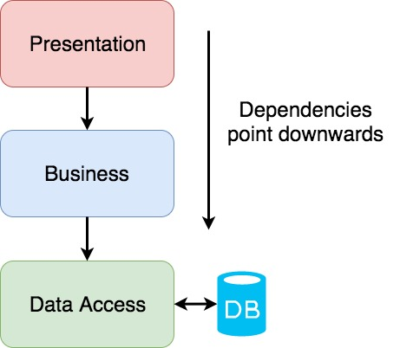
Information flow vs Dependency flow

Slide 11
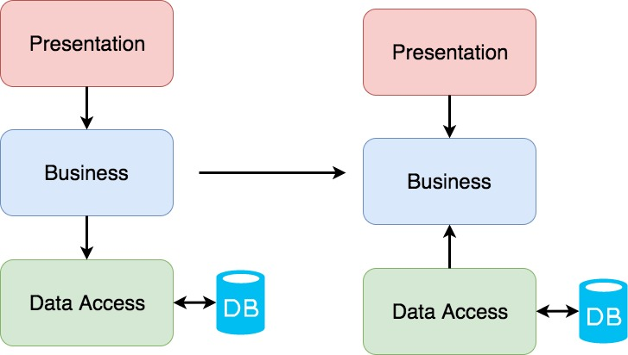
Information flow vs Dependency flow

Slide 12
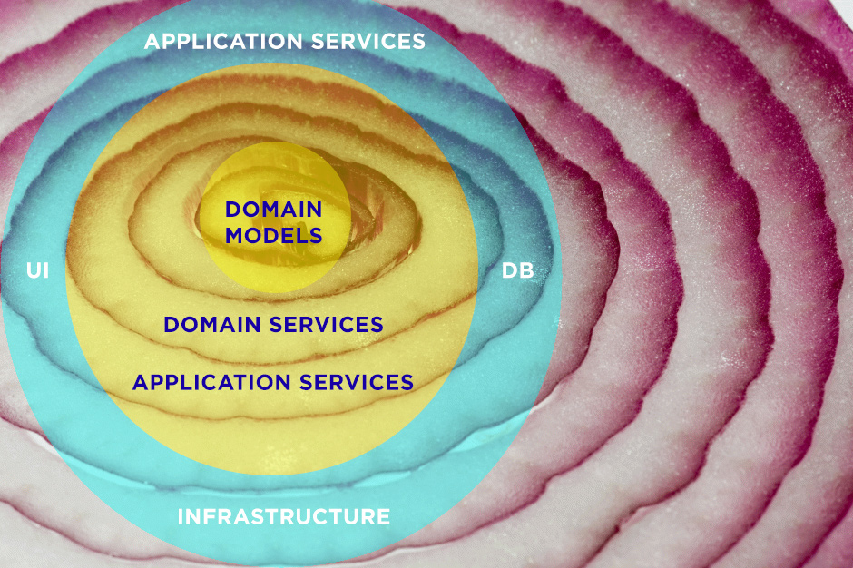
Onion architecture

Slide 13
Exercise I
• Change the Real Estate application in onion architecture

Slide 14
Dependency inversion and injection

Slide 15
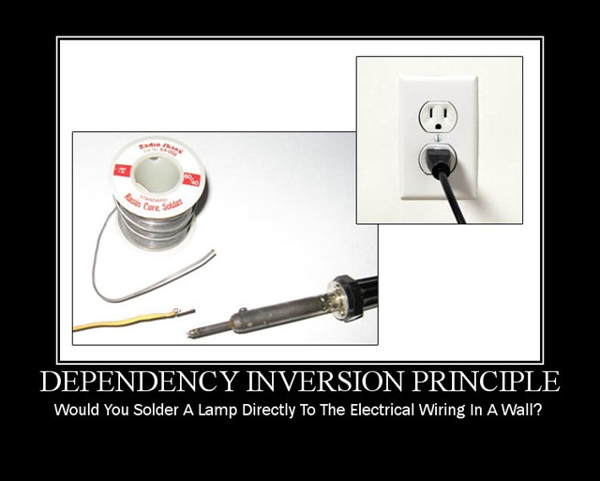

Slide 16
Dependency inversion principle
The Dependency Inversion Principle (DIP): High level modules should not depend upon low level modules. Both should depend upon abstractions.
Abstraction in code is achieved by using interfaces instead concrete classes
Later when the business logic class is used concrete implementation class is injected to be used for the abstracts interface

Slide 17
Methods of injection
• Property injection - Concrete implementation classes are set as parameter to the dependent object. Rarely used method
• Parameter injection - concrete implementation is passed as input parameter in the method from our business logic. May be used if we want our method to use different implementation in different case
• Constructor injection – concrete implementations are passed as parameters in constructor when our business logic class instance is created. Commonly used method in small projects
• IoC Container – Central container of all dependencies in the application. Commonly used method in large projects. There are third party containers like Ninject, Autofac, MEF…

Slide 18
Exercise II
• Add Ninject to the project by using nugget package
• Implement basic IoC Container to the project

